Slide 1
FINAL PROJECT · AI AGENTS
Job Agent
An AI agent that does the boring 95% of job hunting — and leaves the final Submit click to you.
David Zeff · Python + Flask + Groq LLM · live demo included
Notes:
Introduce yourself. One sentence: this is an AI agent that automates the repetitive 95% of job applications, and the demo is live.

Slide 2
01 · THE PROBLEM
Applying to jobs is the same hour, again and again
✕ Search five job boards, one by one
✕ Re-type your details into every form
✕ Tailor the resume — for every single job
✕ Write yet another cover letter
✕ Answer the same 20 questions every time
Notes:
Everyone in the room has felt this. The point: none of these steps require human judgment except deciding to apply.

Slide 3
02 · WHAT IT DOES
Tell it about yourself once
Profile
entered once, stored locally
Search
10 job sources at once
Rank
scored against your profile
Write
tailored resume + letter, fact-checked
You submit
the only manual step
It even fills the employer's real application form — then stops and waits for you.
Notes:
The pipeline in one line. Emphasize the last box: the human only does the final click — by design, not as a limitation.

Slide 4
03 · DEMO
Live demo
1 Profile — dropdowns, GitHub import
2 Find jobs — ranked, with reasons
3 Prepare — watch the AI work
4 Auto-fill a real application form
Notes:
Switch to the app now: Job Agent.command must be running. Show these four things in order, then come back to the slides.

Slide 5
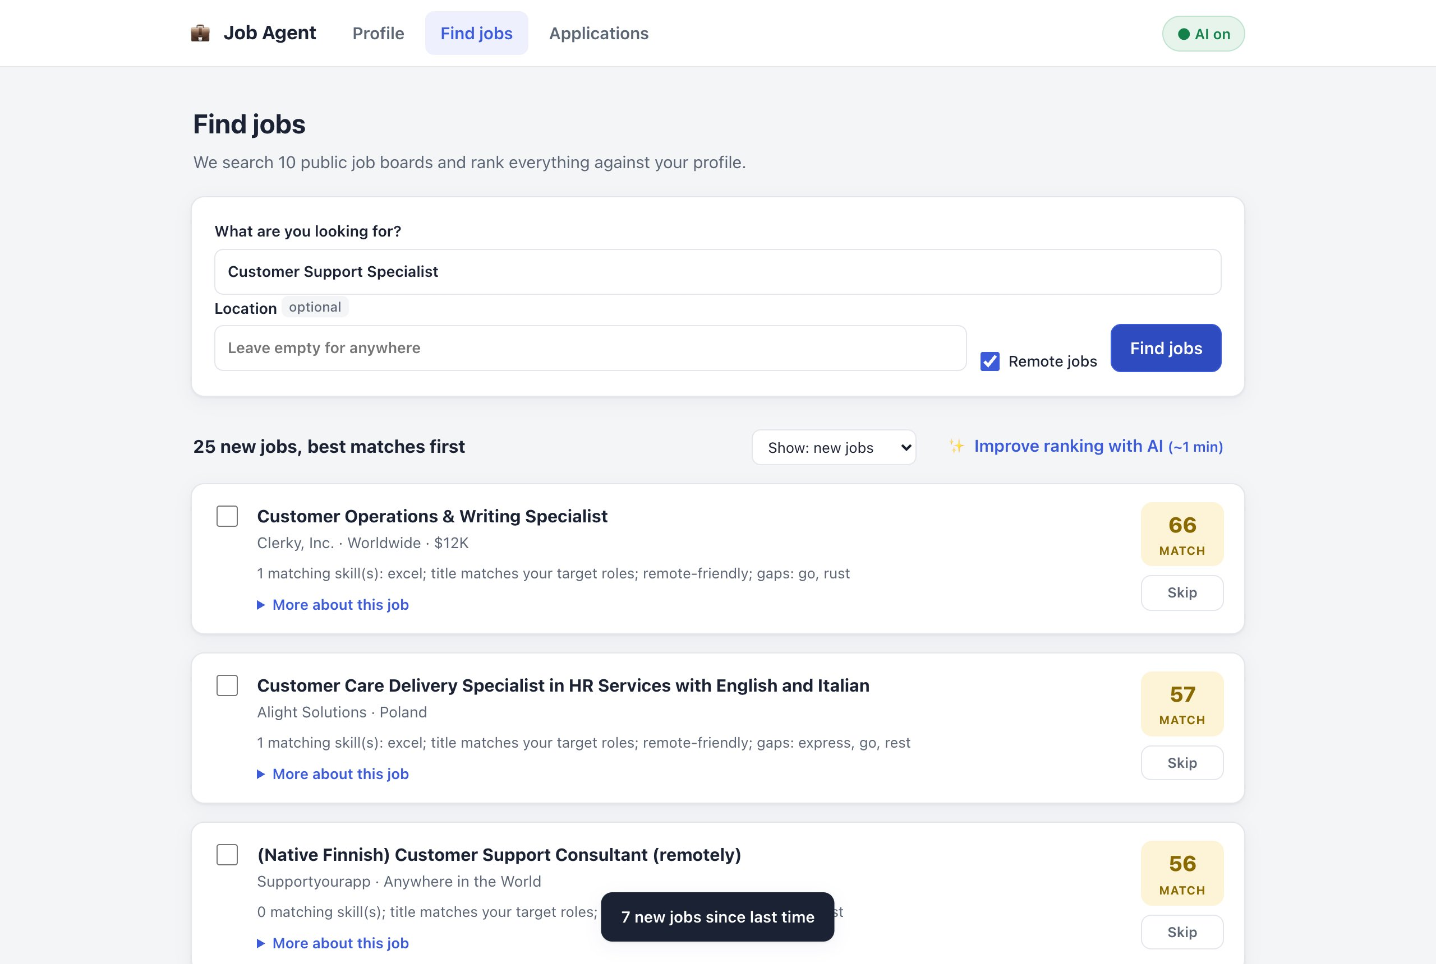
03 · DEMO — FINDING JOBS
Every job gets a match score and a plain-language why — including jobs straight from Israeli company career pages.
Notes:
Ranked results. Point at the match score, the plain-language reasons, and Israeli company jobs (Cato, Via, Similarweb) pulled directly from career pages.

Slide 6
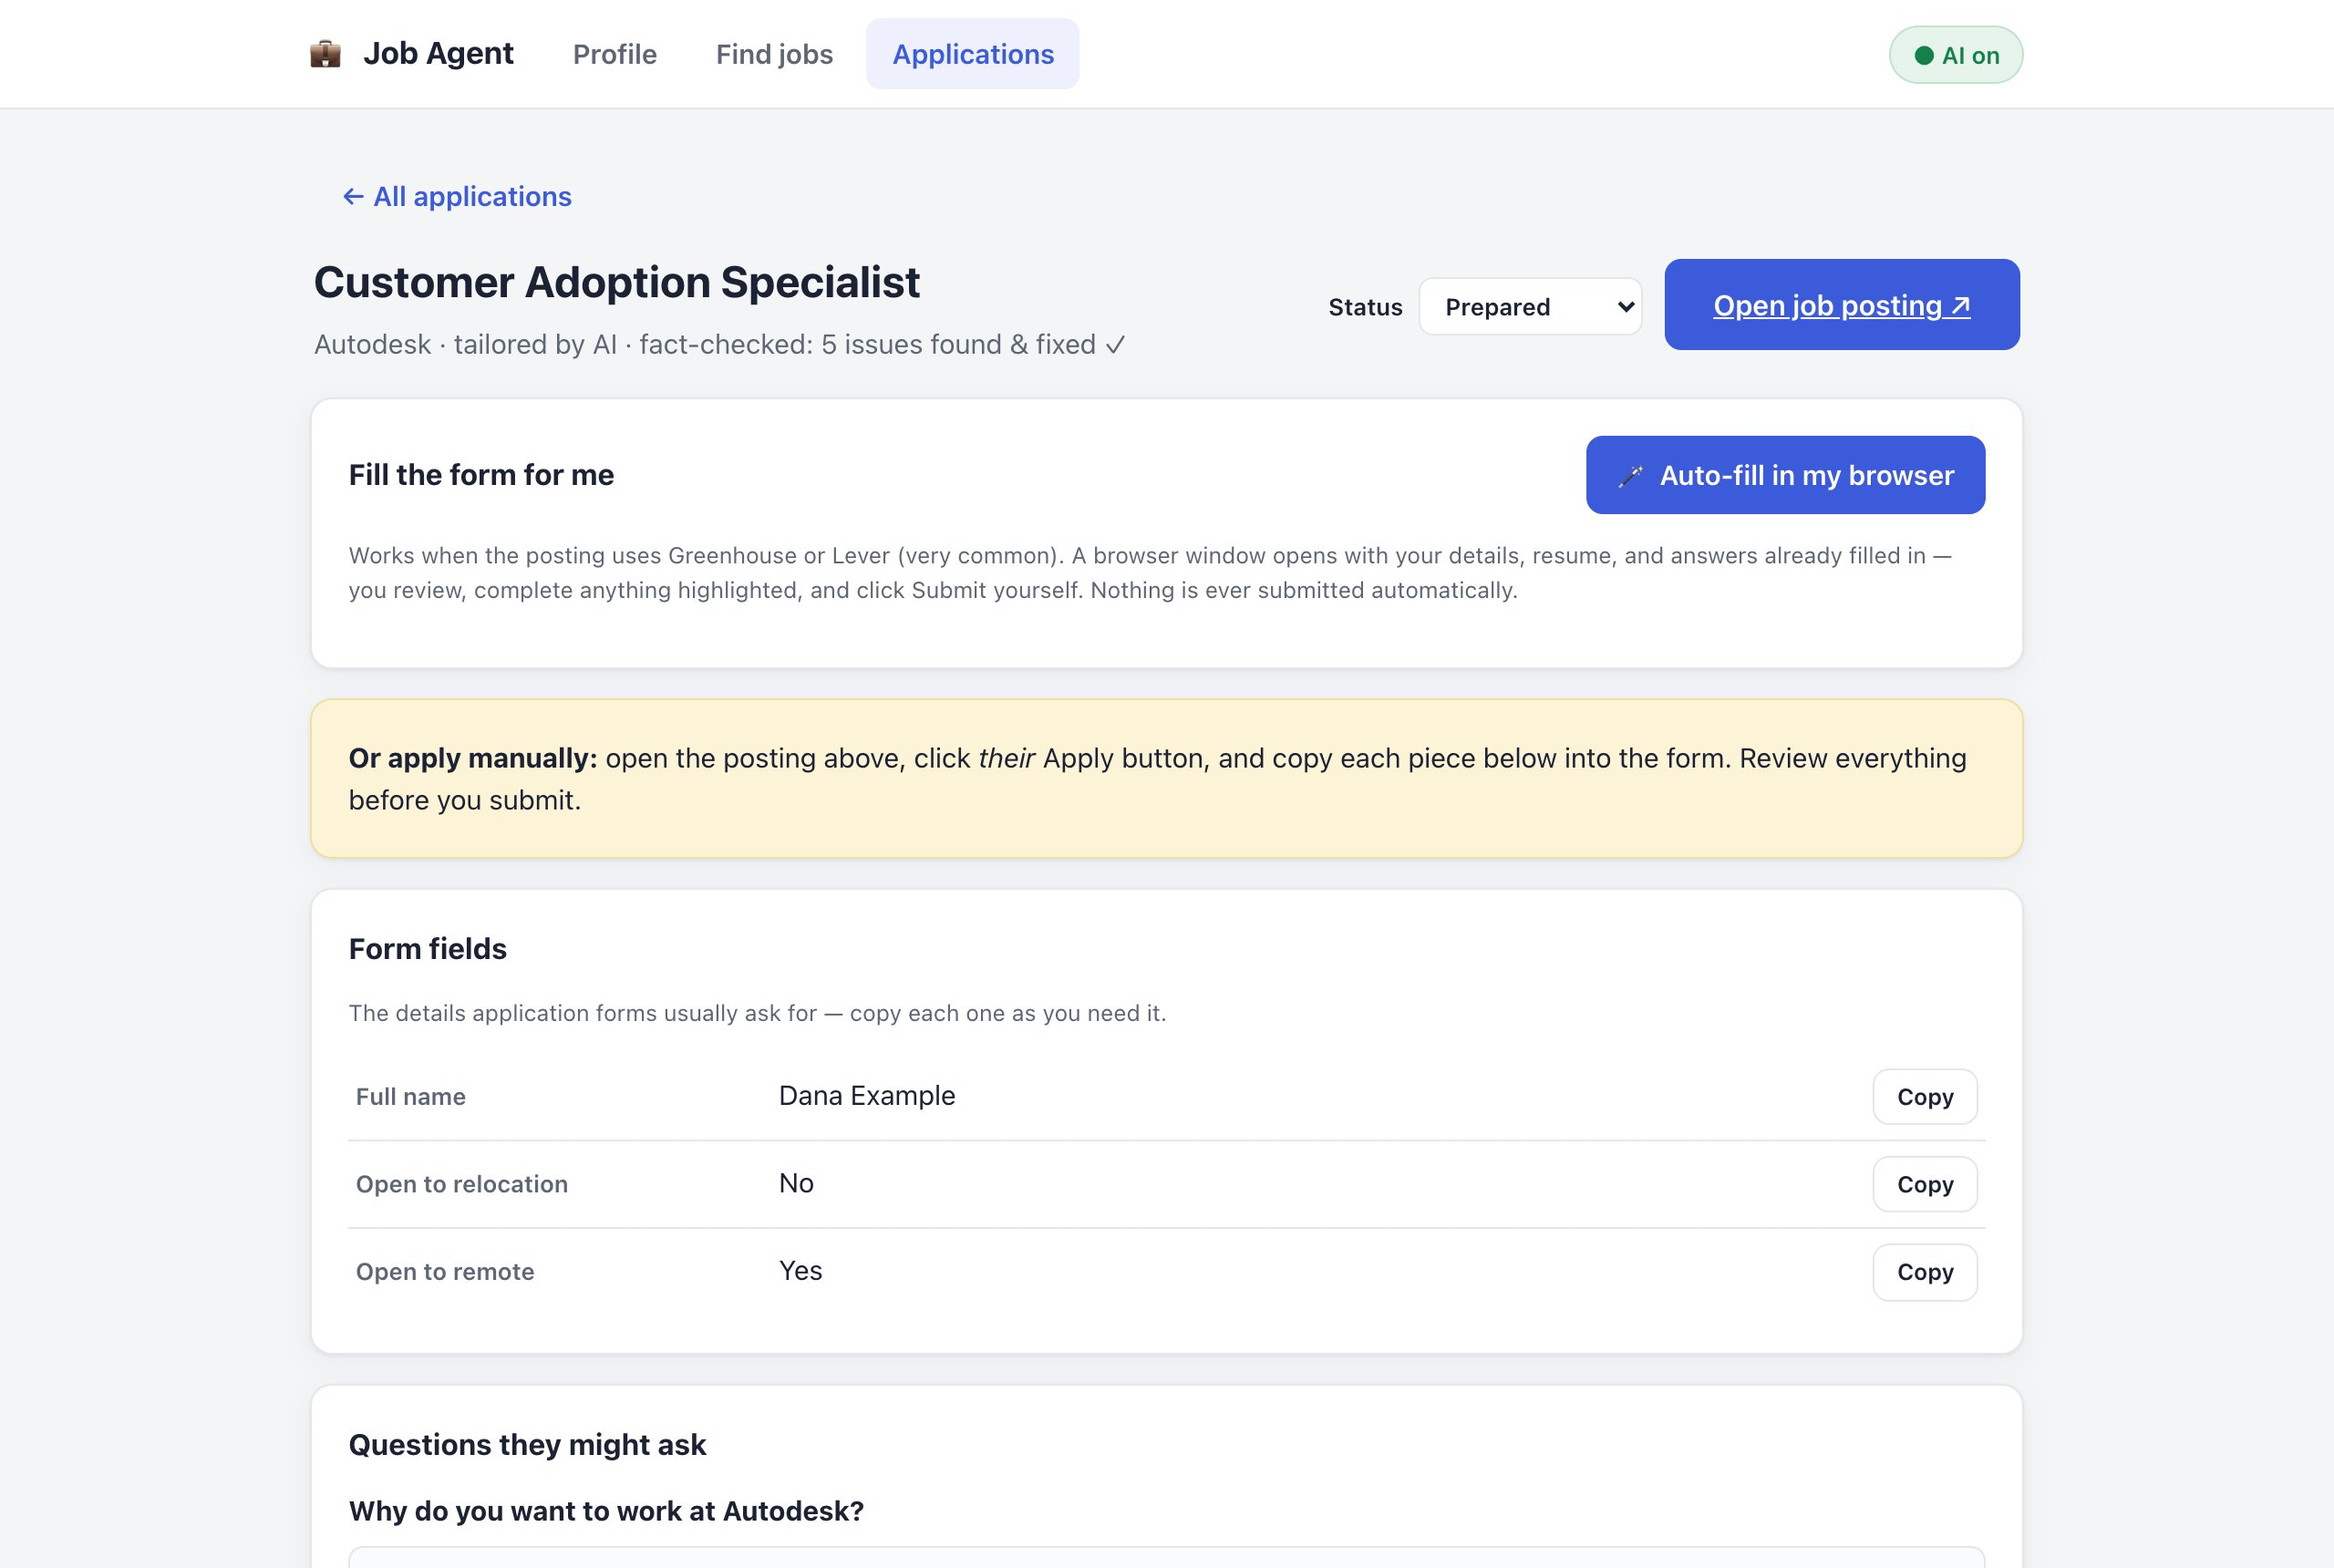
03 · DEMO — A PREPARED APPLICATION
Tailored resume (PDF), cover letter, and every form answer with a Copy button — fact-checked before you see it.
Notes:
A prepared application: tailored PDF resume, cover letter, and copy buttons for every form answer. Note the fact-checked line in the header.

Slide 7
04 · ARCHITECTURE — 1 OF 3
Three ways in, one engine
Web app
for humans — buttons and forms
Terminal
for scripts and power users
"Find me python jobs"
plain-language agent mode
All three call the exact same engine underneath — nothing is duplicated.
Notes:
Architecture part 1: three doors into the same engine. Users click, scripts type, or you just ask in plain language.

Slide 8
04 · ARCHITECTURE — 2 OF 3
The engine: one registry, five modules
Flask API + Tool Registry
every capability defined once — callable by code or by the LLM
scraper
finds jobs on 10 sources
matching
scores each job 0–100
generate
resume · letter · PDF
autofill
fills real forms
tracker
remembers everything
Notes:
Architecture part 2: the tool registry is the key design move — every capability defined once, callable by code or by the AI. Below it, five focused modules.

Slide 9
04 · ARCHITECTURE — 3 OF 3
What it talks to out there
Job board APIs
Remotive · RemoteOK · Jobicy · HN …
Company career APIs
Greenhouse · Lever · Ashby · SmartRecruiters
Groq LLM
llama-3.3-70b — the AI
Your Chrome
makes PDFs + fills forms
All public, documented interfaces — no scraping tricks, no logins, no rule-breaking.
Notes:
Architecture part 3: everything external the engine talks to. Note: the LLM is just one of four external services — not the center of the system.

Slide 10
04 · ARCHITECTURE PRINCIPLE
Deterministic pipeline. AI only where judgment is needed.
Search
plain code
Rank
AI JUDGE
Write
AI WRITER
Review
AI CRITIC
Files & tracking
plain code
No “orchestrator agent” deciding what to do next: the flow is code, so it never gets lost and never burns tokens on planning — and every AI step can fail without breaking the pipeline.
Notes:
Architecture principle: no orchestrator agent. The flow is plain code; the LLM is used only at the points that need judgment. Each AI step can fail and the pipeline still completes.

Slide 11
04 · THE PRINCIPLE IN PRACTICE
Example: how Rank really works
40%
skills overlap
27%
title match
18%
location & remote
15%
seniority fit
Math scores every job
0–100 with plain-language reasons — instant, free, works with no AI at all
AI re-ranks the top 10
a recruiter prompt returns score, verdict, strengths, gaps
Final = 50 / 50 blend
neither the math nor the model decides alone
If the AI call fails, the math score stands — ranking never breaks.
Notes:
The principle made concrete with ranking: transparent math scores every job (weights on screen), the AI re-ranks only the top 10, and the final score is a 50/50 blend. If the AI call fails, the math score simply stands.

Slide 12
05 · AGENTS & TOOLS — 1 OF 5
A tool = a function the model may call
{ "name": "search_jobs",
"description": "Search job boards.
Returns count and sample titles.",
"parameters": {
"keywords": array of string,
"remote": boolean,
"limit": integer } }
# + the Python function that actually runs it
Notes:
What a tool literally is: a JSON description the AI can read, plus the real Python function. This is the actual search_jobs tool from the code.

Slide 13
05 · AGENTS & TOOLS — 2 OF 5
The whole tool system, in code
@dataclass
class Tool:
name: str # "search_jobs"
description: str # what the model reads
parameters: dict # JSON Schema of the arguments
func: Callable # the real Python function
def to_schema(self): # the exact shape the API wants
return {"type": "function", "function": {…}}
class ToolRegistry:
_tools: dict[str, Tool] # the registry IS a dict
def schemas(self): … # all tools, for the model
def dispatch(self, name, args): … # run one by name
~60 lines total. A tool is just data + a function — nothing more.
Notes:
Show that a tool is not magic: one dataclass with four fields, and a registry that is literally a dict. to_schema() emits exactly the shape the LLM API expects. The whole tool system is about 60 lines of code.

Slide 14
05 · AGENTS & TOOLS — 3 OF 5
One registry, two callers
6 tools in one registry
search · rank · list · generate · answer · profile
The fixed pipeline
buttons & terminal call tools in a set order — cheap, reliable
The AI (agent mode)
reads the descriptions and chooses tools itself
Tools return short summaries, not raw data — the model stays focused and cheap.
Notes:
The design move: the same six tools serve two callers. Buttons call them in a fixed order; the AI chooses freely in agent mode. Tools return short summaries to keep the model focused.

Slide 15
05 · AGENTS & TOOLS — 4 OF 5
What “calling a tool” actually means
1 The model never executes anything — it outputs text: a tool name + arguments as a JSON string
2 dispatch(): parse the JSON → look up the tool → run func(**args) → return the result as JSON
3 Every failure becomes a message, never a crash:
{"error": "unknown tool 'serch_jobs'"} # typo'd name
{"error": "arguments were not valid JSON"} # malformed args
{"error": "bad arguments for search_jobs: …"} # wrong params
{"error": "ConnectionError: …"} # the tool blew up
The error goes back into the conversation — the model reads it and fixes its next call.
Notes:
Demystify tool calling: the model only ever outputs text — a tool name plus arguments as a JSON string. dispatch() runs the real function, and every possible failure goes back to the model as a JSON error message it can read and correct. Errors are feedback, not crashes.

Slide 16
05 · AGENTS & TOOLS — 5 OF 5
Tools return summaries — the data stays on disk
→ tool: search_jobs({"keywords": ["python"]})
{"found": 14,
"cached_to": "~/.job_agent/jobs_cache.json",
"sample": ["Python Developer @ …", …]} # ~80 tokens
NOT the 14 full postings # ~15,000 tokens
✓ The full postings go to a cache file; the next tool reads the file, not the conversation
✓ Every agent step stays small → fast, cheap, and inside the free tier's rate limits
Notes:
Context economics: the search tool answers with a count and eight sample titles (~80 tokens), not 14 full postings (~15,000 tokens). The big data goes to a file on disk; the next tool reads the file, not the chat. This keeps every agent step fast, cheap, and inside free-tier rate limits.

Slide 17
06 · THE AGENT LOOP — 1 OF 4
The agent loop, step by step
1 · You ask in plain language
"find remote python jobs, show top 3"
2 · The AI sees the six tool descriptions
and picks a tool + arguments
3 · Our code runs the real function
the AI only asks — it never executes anything itself
4 · Result goes back in; repeat until it can answer
Notes:
The agent loop in four steps. Key point on step 3: the AI never runs anything itself — it asks, our code executes, and the result is fed back.

Slide 18
06 · THE AGENT LOOP — 2 OF 4
The entire agent is ~40 lines
messages = [SYSTEM_PROMPT, user_request]
tools = registry.schemas()
for _ in range(max_steps): # 8 — a hard budget
msg = llm.chat(messages, tools=tools,
tool_choice="auto", temperature=0.2)
if not msg.tool_calls: # no tool wanted =
return msg.content # the answer is ready
messages.append(assistant_turn(msg))
for call in msg.tool_calls:
result = registry.dispatch(call.name, call.args)
messages.append({"role": "tool", "content": result})
return "Reached the step limit…" # can never run away
Notes:
The whole agent fits on one slide — agent.py is 87 lines in the repo including documentation. Point at max_steps (a hard budget: it can never loop forever) and at the exit condition: no tool calls means the model answered in plain text.

Slide 19
06 · THE AGENT LOOP — 3 OF 4
The agent's memory is just this list
[system] You are a job-application assistant…
[user] "find remote python jobs, show top 3"
[assistant] → search_jobs({"keywords": ["python"]})
[tool] {"found": 14, "sample": […]}
[assistant] → rank_jobs({"top": 3})
[tool] {"ranked": 14, "top": […]}
[assistant] "Your top 3 matches are: …" ← plain text: done
✓ The model is stateless — each step it re-reads this whole list and decides the next move
✓ Nothing else persists between steps; when the list ends in plain text, the loop ends
Notes:
The key mental model: the LLM itself is stateless. This growing list of messages IS the agent's memory — every iteration replays the whole list, and the model picks the next move. When it ends in plain text instead of a tool call, the loop is over.

Slide 20
06 · THE AGENT LOOP — 4 OF 4
A real recorded run
$ agent "find remote python jobs,
show top 3, don't apply"
→ tool: search_jobs({"keywords": ["python"],
"remote": true})
{"found": 14, ...}
→ tool: rank_jobs({"top": 3})
{"ranked": 14, ...}
→ tool: list_ranked({"top": 3})
"Your top 3 matches are: …"
Notes:
The same loop, recorded for real: three tool calls, then a plain-text answer. This trace is from an actual run of the project.

Slide 21
07 · SURVIVING THE FREE TIER — 1 OF 2
Every AI call goes through one gate
Any specialist
ranker, tailor, reviewer… none talk to the API directly
Throttle
one shared clock — every thread waits its ≥2s slot
Groq API
llama-3.3-70b
On 429 / 5xx
backoff 2s→30s, honors Retry-After, ≤5 retries
✓ The clock is shared across threads — parallel work still queues politely
✓ Only retryable errors retry (rate limit, overloaded, timeout); real bugs surface at once
The free tier budgets requests and tokens per minute — the whole design lives inside that.
Notes:
Free-tier reality: Groq budgets both requests AND tokens per minute. So one thin wrapper makes every AI call: a process-wide throttle (one clock shared by all threads), exponential backoff that honors the server's Retry-After header, and retries only for genuinely retryable errors.

Slide 22
07 · SURVIVING THE FREE TIER — 2 OF 2
Four rungs to reliable JSON
1 · Ask
every system prompt ends: "Respond with a single valid JSON object and nothing else."
2 · Enforce
Groq's JSON mode rejects non-JSON output at the API level
3 · Retry
JSON mode chokes on Hebrew quotes (ש"ח) — retry once without it
4 · Repair
extract {…} by regex · escape quotes between Hebrew letters · parse again
Only when every rung fails does the step fall back (e.g. untailored resume) — it never crashes.
Notes:
How structured output is forced from a prose model, in four rungs: ask in the prompt, enforce with the API's JSON mode, retry without it when Hebrew quotes break validation, then a repair parser. Only if all four fail does the step fall back — nothing ever crashes.

Slide 23
08 · THE AI CAST — 1 OF 3
Six specialists, not one genius
Ranker
reads a posting like a recruiter; judges fit 0–100 with strengths & gaps
Tailor
rewrites resume + cover letter for one job, in the posting's language
Answerer
answers any form question from your profile — or honestly says “not in profile”
Each gets one narrow prompt and returns structured JSON — nothing free-form.
Notes:
Six specialists instead of one giant prompt — part 1: the three everyday workers. Each has one narrow prompt, one job, its own guardrail.

Slide 24
08 · THE AI CAST — 2 OF 3
…and the quality control
Reviewer
hunts invented facts, wrong company, wrong language in every draft
Repairer
rewrites only what the Reviewer flagged — keeps the rest
Company Scout
proposes employers in your country — each verified against real career APIs before use
The AI can propose; reality decides. Nothing unverified reaches you.
Notes:
Part 2: the quality pair that checks the writer's work (green), and the scout that finds employers in your country — every suggestion verified against real APIs.

Slide 25
08 · THE AI CAST — 3 OF 3
Anatomy of a specialist: the Tailor's cage
ROLES (index in brackets):
[0] Backend Developer at Acme (2022–Present); tech: Python…
[1] QA Engineer at Initech (2019–2022); tech: SQL…
→ bullets must come back keyed by those indexes:
"experience_bullets": {"0": […], "1": […]}
a job that doesn't exist has no index to hang on
✓ Rules first: “Use ONLY facts present in the profile. Never invent employers, titles, dates, degrees…”
✓ The output language is spelled out (“OUTPUT LANGUAGE: Hebrew”) — “match the posting” alone gets ignored
✓ Temperature ladder: Reviewer 0.1 · Ranker 0.2 · Tailor 0.35 — creativity only where it's safe
Notes:
The anti-hallucination cage inside the writer's prompt: experience is sent as a numbered list, and bullets must come back keyed by those numbers — an invented job has no index to hang on. The output language is named explicitly, and temperature drops as the job gets stricter: writer 0.35, judge 0.2, critic 0.1.

Slide 26
09 · MULTI-AGENT QUALITY GATE — 1 OF 3
Writer → Critic → Fix
Tailor writes
draft resume + letter
Reviewer checks every claim
your profile is the only source of truth
Repairer fixes
only the flagged problems
It ships
clean documents + PDFs
Notes:
The multi-agent quality gate: every prepared application passes writer, then critic, then fixer — before you ever see it. The profile is the only source of truth.

Slide 27
09 · MULTI-AGENT QUALITY GATE — 2 OF 3
Catching AI lies — a real test
CAUGHT IN TESTING
The draft claimed a PhD in Physics, “10 years of experience”, a Nobel Prize — and addressed the wrong company
AFTER REPAIR
5 of 5 issues removed — the re-review came back clean ✓
Notes:
Tell the story: we planted a fake PhD, fake years, a Nobel Prize, and the wrong company. The reviewer caught all five; after repair, the re-check came back clean.

Slide 28
09 · MULTI-AGENT QUALITY GATE — 3 OF 3
One click, end to end
POST /api/apply
the button's only job
Tailor
AI · temp 0.35
Review
AI · temp 0.1
Repair
AI · only if flagged
Render documents
code · templates
Your Chrome, headless
HTML → PDF
answers.json + tracker
code
Packet in the UI
copy buttons & files
✓ Each phase reports progress — that's the live ticker you saw in the demo
✓ Every AI step degrades gracefully: tailor fails → untailored resume · review fails → draft kept
Notes:
Everything behind the Prepare button: at most three AI calls (repair only runs if the reviewer flagged something) — the rest is plain code. The progress ticker in the demo is these phases reporting live. Every AI step has a fallback: tailor fails → untailored resume; review fails → draft kept; repair fails → original kept.

Slide 29
10 · GUARDRAILS
Autonomous, not reckless
✓ Documents may only use facts from your profile
✓ Every packet is fact-checked by a second AI pass
✓ AI-suggested companies are verified against real APIs before use
✕ It never clicks Submit — ever
✓ Your data and API key stay on your machine or browser
Notes:
Safety by construction: grounded generation, a second AI pass on everything, verified discovery, and a hard rule — the software cannot click Submit.

Slide 30
11 · THE FORM-FILLER — 1 OF 3
It fills the real application form
Detect the form system
Greenhouse / Lever — aggregator links traced to the real form
Open your Chrome
a script lists every field on the page
Fill + upload resume
code for standard fields, AI for open questions
STOP
gaps highlighted — you review and submit
Notes:
The form-filler agent, step by step. Plain code answers standard fields; the AI answers open questions; and it always stops before Submit.

Slide 31
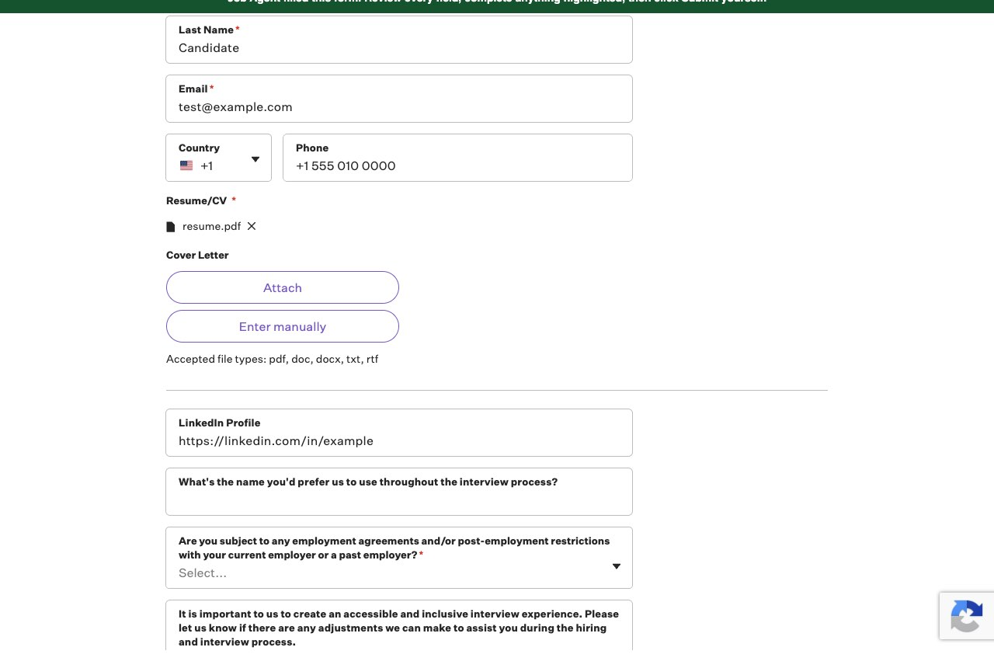
11 · THE FORM-FILLER — 2 OF 3
A real form, really filled
Notes:
Proof on a real company's form (GitLab): name, email, phone filled, resume attached — and the green banner reminding you the last click is yours.

Slide 32
11 · THE FORM-FILLER — 3 OF 3
Inside the form-filler
• Playwright drives a persistent real-Chrome profile — logins and cookies survive between runs
• All browser work funnels through one worker thread + a queue (Playwright is thread-bound)
• Aggregator links are resolved by downloading the page and regex-finding the real Greenhouse / Lever URL
• A JS snippet tags every field and reports its label, type, options, and required flag
• Answers cheapest-first: profile fields → rule-based choices → AI, budgeted at 8 AI calls per form
• One broken field is skipped, never fatal — and no code path exists that clicks Submit
Notes:
Form-filler internals: one worker thread owns the browser because Playwright's sync API is thread-bound; a persistent Chrome profile keeps logins between runs; aggregator links are resolved by regex-hunting the real ATS URL in the page; answers go cheapest-first with a hard budget of 8 AI calls per form; and no code path clicks Submit.

Slide 33
12 · WHERE THE JOBS COME FROM — 1 OF 3
9 public boards, searched at once
Always on — no keys, no accounts
Remotive · RemoteOK · Arbeitnow · Jobicy · Himalayas · WeWorkRemotely · Hacker News “Who is hiring” · The Muse · Working Nomads
Optional aggregators (free keys in Settings)
Jooble — ~69 countries incl. Israel · Adzuna — 20 countries of local on-site jobs
Notes:
Where the jobs come from, part 1: nine public job boards searched in parallel, plus two optional aggregators unlocked with free keys.

Slide 34
12 · WHERE THE JOBS COME FROM — 2 OF 3
…plus your country's actual companies
Automatic from your profile's country
109 verified employers shipped for 9 countries. Israel: NICE · Via · Cato · Gong · Similarweb · Taboola · JFrog · Fireblocks · AppsFlyer … (29 total)
Unknown country? The AI scouts it
AI proposes employers → each verified against real career APIs → cached 30 days. Spain test: Cabify, Typeform, Wallapop — 83 real openings
Notes:
Part 2: the country layer. 109 verified company boards ship with the app (29 Israeli). For any other country, the AI proposes employers and each one is verified live, then cached.

Slide 35
12 · WHERE THE JOBS COME FROM — 3 OF 3
Inside the scraper
• One small fetcher per source — 12 of them — each normalizing into the same Job record
• A dead API prints a warning and returns nothing — the search itself never fails
• Company career boards fan out on a 10-thread pool — up to 30 boards per search
• Boards' own search is unreliable, so relevance is scored client-side: title hit > tag hit > description hit
• Dedupe by URL and title+company; company jobs capped to half the list, round-robin per employer
The fetchers are the easy part — the aggregation layer is where quality happens.
Notes:
Scraper internals: 12 small fetchers all normalize into one Job record; each isolates its own failures so a dead API never kills the search; up to 30 company boards are fetched on a 10-thread pool; relevance is scored client-side title-first because boards' own search is unreliable; then dedupe and a round-robin cap keep variety.

Slide 36
13 · BILINGUAL BY DESIGN
Hebrew posting? Hebrew resume.
✓ The posting's language decides the documents' language — not the profile's
✓ Full right-to-left layout: headings, bullets, dates — ניהלתי תקציב של 250,000 ש״ח
✓ Hebrew quotes broke the model's JSON (ש"ח) — fixed with an automatic repair layer
Notes:
Language follows the posting, not the profile. Hebrew needed real bidi work — and Hebrew quote marks even broke the model's JSON until we added a repair layer.

Slide 37
14 · STATE & STORAGE
No database. State is a folder of files.
~/.job_agent/
profile.json # your profile — the single source of truth
jobs_cache.json # the last search's results
ranked.json # the scored & sorted list
seen.json # every job ever seen + its status
companies_cache.json # AI-discovered employers (30-day TTL)
applications/
acme__backend-dev/ # resume.md · resume.pdf · cover_letter.md
# answers.json · job.md
browser/ # the persistent Chrome profile
✓ Each stage writes files, the next reads them — files are the interface between stages
✓ Hosted mode swaps this folder for the visitor's own browser storage — the server stays stateless
Notes:
No database: the entire state is a readable folder of JSON files — which is also why tools can answer with tiny summaries; the data sits in files between stages. Everything is debuggable with a text editor. Hosted mode swaps this folder for the visitor's browser storage and the server stays stateless.

Slide 38
15 · RUNS ANYWHERE
Desktop app and a website
Desktop (double-click)
full powers: form autofill · background auto-search · auto-prepared applications · PDF files
Vercel (hosted)
stateless server — your profile, key, history and applications live in your own browser; nothing stored server-side
Same code, one flag. The app hides what each home can't do — with an explanation.
Notes:
Same codebase, one flag. Desktop has the machine-bound powers; the hosted version is stateless — each visitor's data lives in their own browser.

Slide 39
16 · BY THE NUMBERS
Small system, real work
10
job sources searched in one pass
109
verified company boards · 9 countries
~15s
per tailored application (2 in parallel)
5
AI calls per application — incl. fact-check
21×2
automated end-to-end checks, desktop + hosted
0
frameworks: Flask + vanilla JS + Playwright
Notes:
Close the technical story with scale and rigor: parallel preparation, five AI calls per application including the fact-check, and a 21-check automated E2E in both modes.

Slide 40
THANKS
Questions?
github.com/DavidZeff1/agent
Python · Flask · Groq (llama-3.3-70b) · Playwright · your own Chrome
Notes:
Q&A. If asked about code: github.com/DavidZeff1/agent — the README documents the architecture and design decisions.

